Slide 1
Operators & Expressions in C

Slide 2
Introduction to Operators
Operators are the special symbols which are used to indicate the type of operation.
Operands are variables or data member which are used in conjunction with operators to evaluate the expression.
Combination of operands and operators form an expression.
Expressions are sequences of operators, operands, and punctuators that specify a computation.
Evaluation of expressions is based on the operators that the expressions contain and the context in which they are used.
One expression contains set operators and operands.
.

Slide 3
Operators in C
Type | Operator | Meaning | For Example
Arithmetic 1. Binary 2. Unary | + - * / % ++ -- | Addition subtraction Multiplication Division Mod Increment by one Decrement by one | C=a+b C=a-b C=a*b C=a/b a%b ++a or a++ --b or b--
Relational | < > <= >= = = != | Less than Greater than Less than equal to Greater equal to Equal to Not equal to | a<4 a>4 a<=4 a>=4 a= =4 a!=4
Logical | && || ! | And OR NOT | 0 && 1 0 || 1 !(0 && 1)
Assignment | =, +=, -=,*=,/= | is assigned to | a=5

Slide 4
Operators in C (Cont.)
Type | Operator | Meaning | For Example
Conditional | ? | condition?expression1:expression2 | Eg. a>b?true:false C=4>5?1:0 D=5>2?1:0
sizeof | sizeof() | Finds out the size of the data type used | a=sizeof(int); b=sizeof(2); c=sizeof(float); D=sizeof(char);
Bitwise operators | & | ~ >> << (A+b)*c/d * / + | AND OR 1’s Complement Right Shift Left Shift ++a + ++c | 8 & 10 8: 00001000 10: 00001010 result: 00001000
Type | Operator | Meaning | For Example
Conditional | ? | condition?expression1:expression2 | Eg. a>b?true:false
sizeof | sizeof() | Finds out the size of the data type used | a=sizeof(int); b=sizeof(2); c=sizeof(float); D=sizeof(arr[0]);
Bitwise operators | & | ~ >> << | AND OR 1’s Complement Right Shift Left Shift | 8 & 10 8: 00001000 10: 00001010 result: 00001000
Type | Operator | Meaning | For Example
Conditional | ? | condition?expression1:expression2 | Eg. a>b?true:false
sizeof | sizeof() | Finds out the size of the data type used | a=sizeof(int); b=sizeof(2); c=sizeof(float); D=sizeof(arr[0]);
Bitwise operators | & | ~ >> << | AND OR 1’s Complement Right Shift Left Shift | 8 & 10 8: 00001000 10: 00001010 result: 00001000

Slide 5
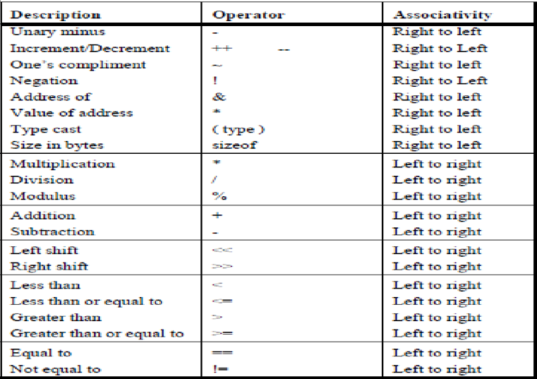
Precedence and Associativity

Slide 6
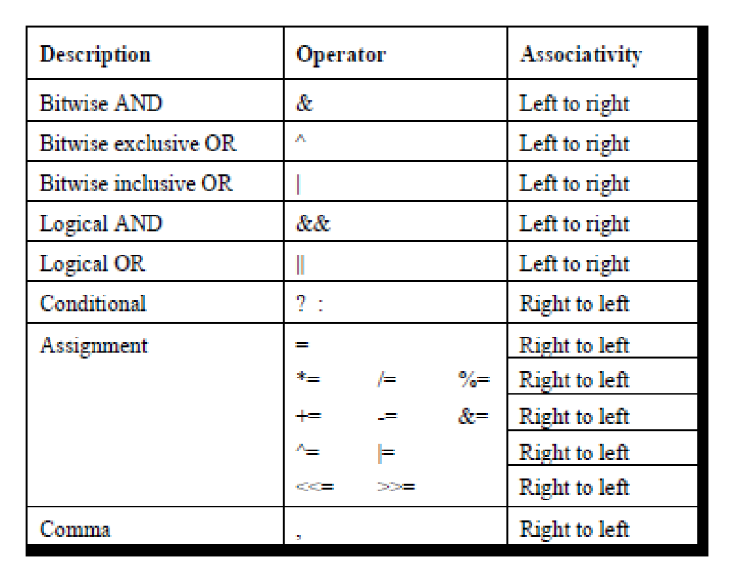
Precedence and Associativity (Cont.)

Slide 7
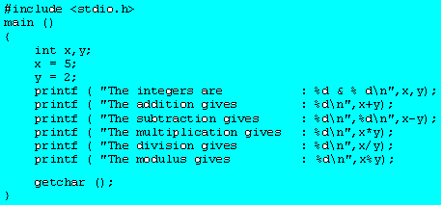
1.Arithmetic operator
1.Arithmetic operator: These are used to perform arithmetic/mathematical operations on operands
Examples: (+, -, *, /, %,++,–). Arithmetic operator are of two types:
Unary Operators: Operators that operates or works with a single operand are unary operators. For example: (++ ,- –)
Binary Operators: Operators that operates or works with two operands are binary operators. For example: (+ , – , * , /)

Slide 8
Example 1 Binary operators
Determine the hierarchy of operations and evaluate the following expression, assuming that kk is float variable.
kk= 3 – 5 * 7 / 8 + 6 / 2
The +, - group has lower precendence than the *, / % group.
3 – 5 * 7 / 8 + 6 / 2 operation: *
3 – 35 / 8 + 6 / 2 operation: /
3 – 4.375 + 6 / 2 operation: /
3 – 4.375 + 3 operation: -
-1.375 + 3 operation: +
1.625

Slide 9
Example 2
Arithmetic Operators
% is a modulus operator. x % y results in the remainder when x is divided by y and is zero when x is divisible by y.
Cannot be applied to float or double variables.
Example
if ( num % 2 == 0 )
printf(“%d is an even number\n”, num)’;
else
printf(“%d is an odd number\n”, num);

Slide 10
UnaryOperator (Increment and Decrement Operators)
Unary Operators: Operators that operates or works with a single operand are unary operators. For example: (++ ,- –)
int a, b, c = 0;
a = ++c;
b = c++;
printf(“%d %d %d\n”, a, b, ++c);
Output: /* 1 1 3 is printed */
c is incremented making its value 1.
The result assigned to a making its value 1.
The value of c is assigned to b making its value 1.
Then c is incremented making its value 2.
Finally, c is incremented before it is printed, making its value 3.

Slide 11
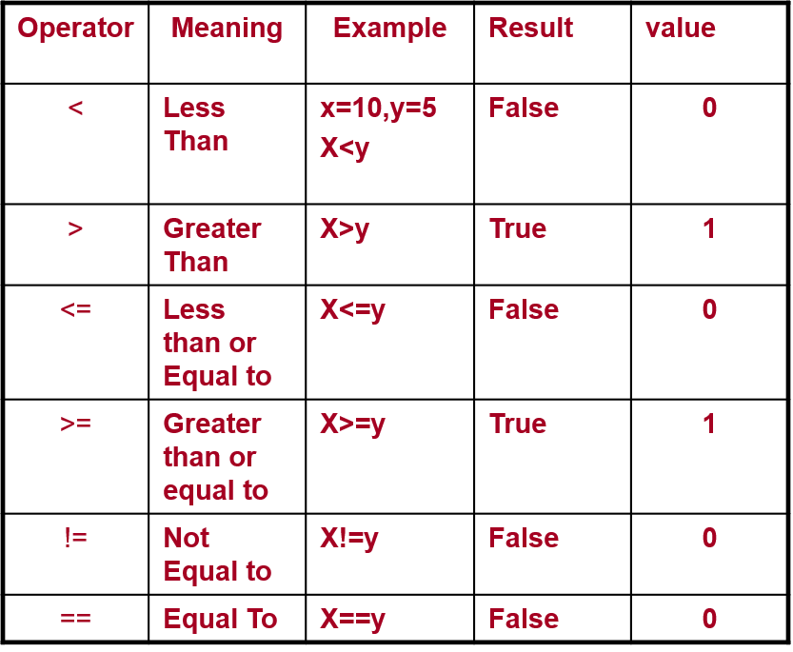
2.Relational operator
Relational operator:These are used for comparison of the values of two operands.
For example, checking if one operand is equal to the other operand or not, an operand is greater than the other operand or not etc. Some of the relational operators are (==, >= , <= )
Relational operators are used to test the relationship between two variables or constant.
takes a value of 1(int) if the relationship is true and 0(int) if relationship is false.
Example
int a = 25, b = 30, c, d;
c = a < b;
d = a > b;
value of c will be 1 and that of d will be 0.

Slide 12
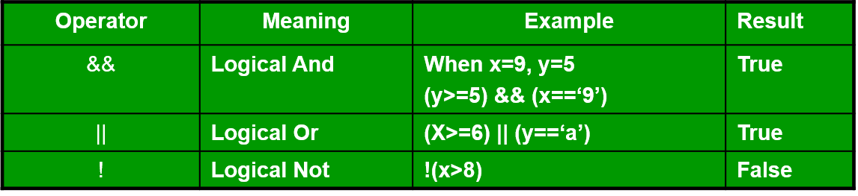
3.Logical operators
logical operators : Logical operators are used to combine two or more relational expressions. This operator is used to test more than one condition at a time.
For example, a && b returns true when both a and b are true (i.e. non-zero).
For example, a || b returns true if one of a or b or both are true (i.e. non-zero).
For example, !a returns true if a is false, i.e. when a=0.

Slide 13
3.Logical operators
logical operators :For example, a && b returns true when both a and b are true (i.e. non-zero).
For example, a || b returns true if one of a or b or both are true (i.e. non-zero).
For example, !a returns true if a is false, i.e. when a=0.
A=10 b=-5
(A>=6 ) && (b<=3) | TRUE
(A>-2 ) && (b>=3) | FALSE
(A==6 ) || (b>=3) | FASLE
(A<=7 ) || (b==-5) F T | TRUE

Slide 14
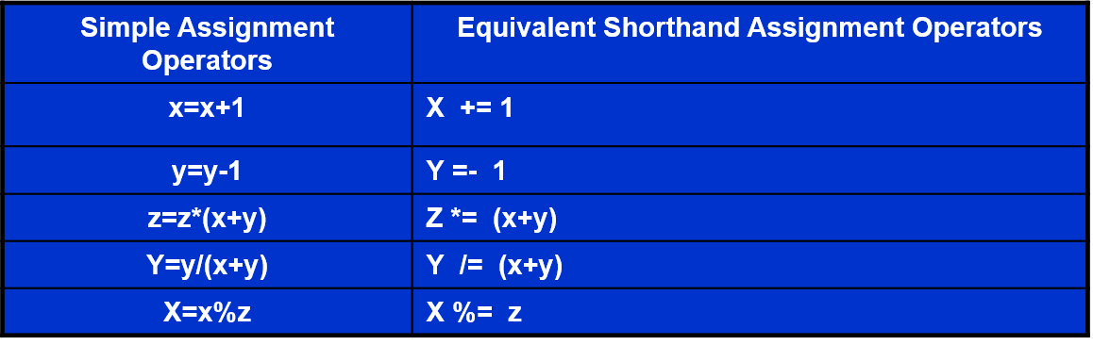
4.Assignment Operator
In C, the assignment operator(=) can be used for assigning a value to a variable.
Syntax : Variable_name = Expression Lefthandside_Variable Righthandside Value Assignment Operator

Slide 15
5.Bitwise Operator
It is used to perform bit-level operations on the operands. The operators are first converted to bit-level and then the calculation is performed on the operands. the bitwise AND represented as & operator in C. The result of AND is 1 only if both bits are 1.
Used in applications which require manipulation of individual bits within a word of memory
There are six bit operators:
bitwise AND(&)
bitwise OR(|)
bitwise XOR(^)
bitwise complement(~)
left shift(<<)
right shift(>>)

Slide 16
Uses of Bitwise operators
Bitwise operators are a particular type of operators in C used for bit-level programming.
It is essential to know the use of the bitwise operator as it brings an efficient way of saving space in representing data.
Programmers use these operators in various fields, such as systems programming, embedded programming, and designing protocols.
Hence, programmers need to know its use.

Slide 17
Bitwise Operators(contd.)
Bitwise operator: computer understands data in the form of 0’s and 1’s. so every data which is being supplied is converted into 0’s and 1’s.
C provides us the facility to manipulate these bits using some special operators called as bitwise operators.
Note: bitwise operations can be performed only on integer and character type data.
The bitwise operators are as follows:
Bitwise operator | Meaning
& | And
| | or
~ | 1’s compliment
>> | Right shift
<< | Left shift

Slide 18
Bitwise Operators(contd.)
Truth Table
A | B | AND | OR | XOR
0 | 0 | 0 | 0 | 0
0 | 1 | 0 | 1 | 1
1 | 0 | 0 | 1 | 1
1 | 1 | 1 | 1 | 0

Slide 19
Bitwise Operators
Bitwise AND operator: it operates on two operands.
While operating upon these two operands they are compared on bit by bit basis.
Both operands must be of the same type(either Char or int).
The second operand is often called an AND mask.
Example: 8 & 10
8: 0 0 0 0 1 0 0 0
10: 0 0 0 0 1 0 1 0
result: 00001000=8
It is used to check whether a particular bit of an operand is ON
or OFF.
Example2: 12 & 17 12: 0 0 0 0 1 1 0 0
17: 0 0 0 1 0 0 0 1
12 & 17 : 0
.

Slide 20
Bitwise Operators(contd.)
Bitwise OR operator: it operates on two operands.
While operating upon these two operands they are compared on bit by bit basis.
Both operands must be of the same type(either Char or int).
Example: 8 | 7
8: 00001000
7: 00000111
Result: 00001111
It is usually used to put ON a particular bit in a number.
Example: 19 | 11
19: 0 0 0 1 0 0 1 1
11: 0 0 0 0 1 0 1 1
19 |11: 0 0 0 1 1 0 1 1 =27
.

Slide 21
Bitwise Operators(contd.)
Bitwise XOR operator: it operates on two operands.
It is used to toggle (change) a bit ON or OFF.
Example: 21 ^ 37
21: 00010101
37: 00100101
Result: 00110000
= 48 (in decimal)
34 ^ 23:
one’s Compliment:
x= 00001001
~x=11110110

Slide 22
Bitwise Operators(contd.)
The right shift operator is represented by >>. It needs two
operands.
It shifts each bit in its left operand to the right. The
number of places the bits are shifted depends on the number
following the operator (i.e. its right operand).
Thus, ch >> 3 would shift all bits in ch three places to the right.
Similarly, ch >> 5 would shift all bits 5 places to the right.
For example, if the variable ch contains the bit pattern 11010111,
then, ch >> 1 would give 01101011 and ch >> 2 would give
00110101.
Note that as the bits are shifted to the right, blanks are created on
the left. They are always filled with zeros.
.

Slide 23
Bitwise Operators(contd.)
12 >> 1
0 0 0 0 1 1 0 0 >>1
0 0 0 0 0 1 1 0 : 6
0 | 0 | 0 | 0 | 1 | 1 | 0 | 0
 | 0 | 0 | 0 | 0 | 1 | 1 | 0

Slide 24
Bitwise Operators(contd.)
7 >> 1
0 0 0 0 0 1 1 1
0 0 0 0 0 0 1 1 : 3
24 >> 1 : 12
12 >> 2 ( 2^2=4)
0 0 0 0 1 1 0 0 >>2
0 0 0 0 0 0 1 1=3
24>>2=6
24>>3 (2^3=8)=3

Slide 25
Bitwise Operators(contd.)
Note that if the operand is a multiple of 2 then shifting the operand
one bit to right is same as dividing it by 2 and ignoring the
remainder. Thus,
x>>n is equal to x/2^{n}
Example:
64 >> 1 gives 32
00000000 01000000 (64 in binary)
first right shift gives 0000000000100000 = 32(decimal)
64 >> 2 gives 16
128 >> 2 gives 32
but,
27 >> 1 is 13
49 >> 1 is 24 .

Slide 26
Bitwise Operators(contd.)
Left shift operator:
This is similar to the right shift operator, the only difference being
that the bits are shifted to the left, and for each bit shifted, a 0 is
added to the right of the number.
x<<n is equivalent to multiplication by 2^{n} .
Example:Decimal 32 is same as binary 00000000 00100000
32 left shift 1 gives 00000000 01000000
32 left shift 2 gives 00000000 10000000

Slide 27
Bitwise Operators(contd.)
12 << 1 (2^1=2)
0 0 0 0 1 1 0 0 <<1
0 00 1 1 0 0 0 :24
7 << 1
0 0 0 0 0 1 1 1
0 0 0 0 0 0 1 1 : 3
24 >> 1 : 12
12<< 2 ( 2^2=4)=48
0 0 0 0 1 1 0 0 >>2
0 0 0 0 0 0 1 1=3
24>>2=6
24>>3 (2^3=8)=3

Slide 28
Bitwise Left shift operator Example
//Left shift operator
# include<stdio.h>
void main( )
{ char c1 = 1,c2 = 2,c3 = 3;
c3 = c1<<2;
printf("\n left shift by 2 bits c1 << 2 = %c",c3);
}
c3 = c1 << 2;
The bits are shifted left by two places.
c1 is 0000 0100
It is shifted 2 bits to the left
0001 00**
While shifting, the high-order (left) bits are discarded.
The vacuum on the right side is filled with 0s.

Slide 29
Example of Bitwise And Operator
Bitwise and:
c1 & c2
# include<stdio.h>
void main( )
{ char c1 = 4,c2 = 6,c3 ;
c3 = c1 & c2;
printf("\n Bitwise AND i.e. c1 & c2 = %d",c3);
}
Bitwise AND i.e. c1 & c2 = 4
Suppose c1 = 4, c2 = 6;
The value of c1 & c2 is interpreted: 0000 0100 & 0000 0110
0000 0100

Slide 30
6.Conditional (ternary) Operator
Conditional operator:
condition?expression1:expression2
True condition False condition
Eg.x= a>b?111:222
A=10 b=20
Comma operator: used to separate variables statements in a control statement and to separate multiple conditions in a conditional statement.
eg. A) int a,b,c B) for(i=0,j=0;i<10;i++)

Slide 31
Example 3
Determine the hierarchy of operations and evaluate the following expressions
Assume a=13, b= 25 and c=5
1. z=a^b;
2.x=++a – b;
3.y=b++ +c;
4.x=c>b ? 1:0 ;

Slide 32
Sizeof Operator
Sizeof operator: returns the number of bytes the operand occupies. The operand could be a variable, constant or a data type.
Used for finding length of structures and arrays.
Int x,y,z,m;
E.g: x=sizeof(m);
y=sizeof(float);
z=sizeof(‘A’);
& operator : it returns the address of a variable.
* operator: it returns pointer to a variable.

Slide 33
Comma Operator
Comma Operator: The comma operator used to link the related expressions together. A comma linked-list of expressions are evaluated left-to-right and the value of rightmost expression is the value of the combined expression.
Example: value = (x=10,y=5,x+y);
For (n=1, m=10 ; n<=m ; n++, m++)

